Slide 1

Microsoft Word 2007 – Level 2
Chapter 2
PROOFING DOCUMENTS

Slide 2

Performance Objectives
Complete a spelling and grammar check on text in a document
Create a custom dictionary and change the default dictionary
Display synonyms and antonyms for specific words using the Thesaurus
Display document, word, paragraph, and character counts
Use the translation feature to translate word from English to other languages
Search for and request information from online sources

Slide 3
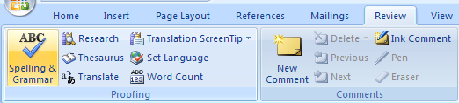
Check Spelling and Grammar
Review tab,
Spelling & Grammar
OR
Press the F7 key

Slide 4

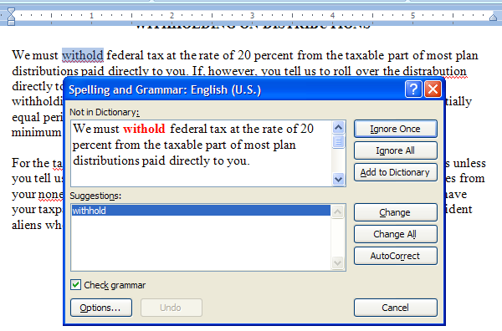
Checking the Spelling
Spelling & Grammar button
OR
F7
Select
appropriate
button
Spelling
suggestion
You can temporarily leave the dialog box, make corrections in the document, and then resume spell checking.

Slide 5
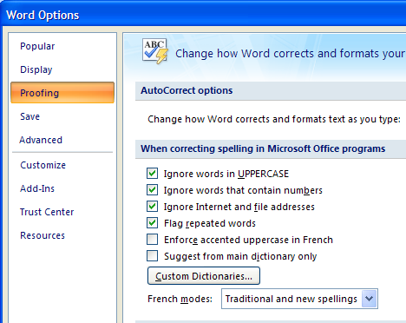
Changing Spelling Options
Office, Word Options, Proofing

Slide 6
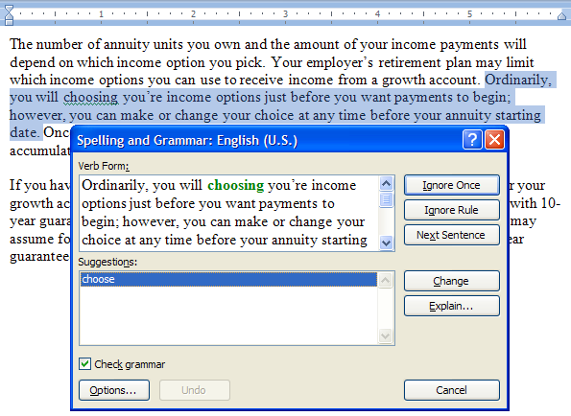
Checking the Grammar and Style
Spelling and Grammar button
Select
appropriate
button
Grammar
suggestion

Slide 7
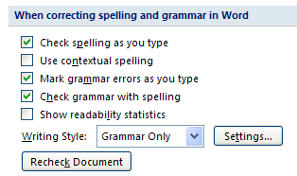
Changing Grammar Options
Office, Word Options, Proofing

Slide 8
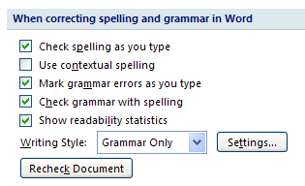
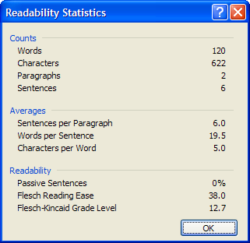
Displaying Readability Statistics
Word Options,
Proofing
…to show this when Spelling & Grammar check finishes
Check this

Slide 9
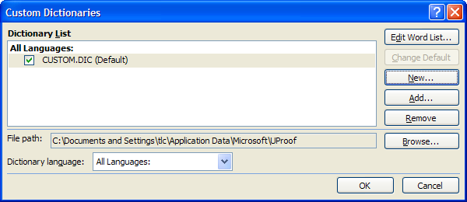
Creating a Custom Dictionary
Office, Word Options, Proofing
Click New to create your own
Click

Slide 10
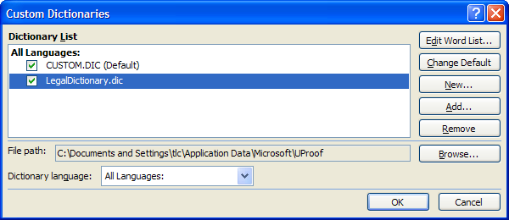
Changing the Default Dictionary
Office, Word Options, Proofing
Select and click to
change the default
Click

Slide 11
Removing a Dictionary
Office, Word Options, Proofing, Custom Dictionaries…
Select and click to
remove the dictionary

Slide 12
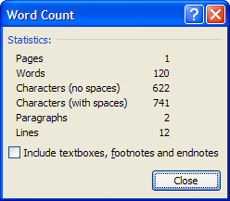
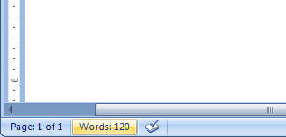
Displaying Word Counts
Review tab, Word Count
OR
Click to show Word Count dialog box
Can also show count of selected text
Word counts as you type

Slide 13
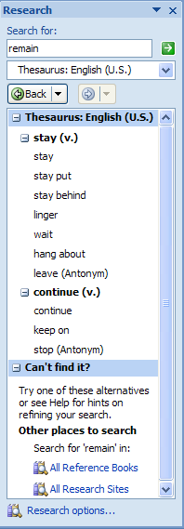
Using the Thesaurus
Review tab, Thesaurus
or Shift + F7
Type word
Click
or press Enter
Synonyms are displayed;
antonyms also displayed
if available

Slide 14
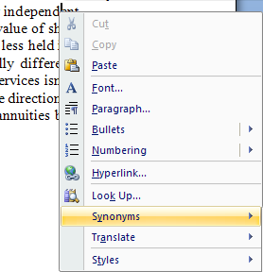
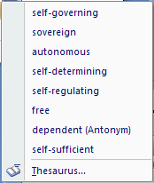
Displaying Synonyms Quickly
Right-click in desired word
Point to
Synonyms and antonyms are displayed

Slide 15
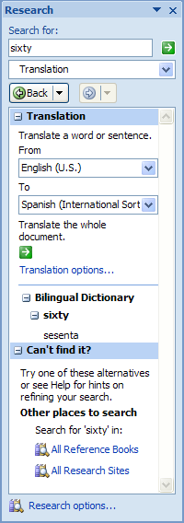
Translating Text
Review tab,
Translate*
Type the word
Click drop-
down arrow
Translation
*Feature must be installed to use

Slide 16
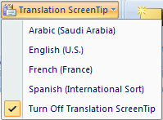

Using Translation ScreenTips
Review tab,
Translation Screen Tip
Click choice
Place mouse pointer over a word to display a translation screen tip
*Feature must be installed to use

Slide 17
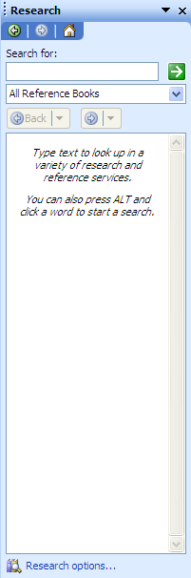
Researching/Requesting Information
Review tab,
Research
Click to display list of reference
books, research sites, business
and financial services, and
other services
Click to change options

Slide 18
Features Summary
How do you display the Spelling and Grammar dialog box?
Review tab,
Spelling & Grammar
OR
Press the F7 key

Slide 19
Features Summary
How do you customize the spell checking options?
Office, Word Options, Proofing

Slide 20
Features Summary
How do you customize the grammar checking options?
Office, Word Options, Proofing

Slide 21
Features Summary
How do you create your own custom dictionary?
Office, Word Options, Proofing
Click New to create your own

Slide 22
Features Summary
How do you display the Word Count dialog box?
Review tab, Word Count
OR
Click in Status bar
Can also show count of selected text

Slide 23
Features Summary
How do you show the Readability Statistics for a document ?
Office, Word Options, Proofing,
check ‘Show Readability Statistics’
… shows when next Spelling & Grammar check finishes

Slide 24
Features Summary
How do you display the Research task pane?
Review tab,
Thesaurus
or
Research
or
Translate

Slide 25
Coming Next
Chapter 3
AUTOMATING AND CUSTOMIZING FORMATTING

